Slide 1
SWE’s 2020 Online Conference
Thursday, August 13 Noon CT
precisely BORDEAUX: Teaching One of the Classic Fine Wine Regions
Gary Twining, CWE

Slide 2
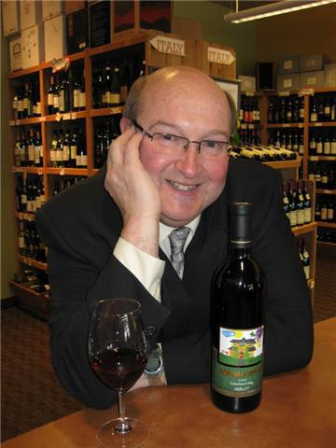
precisely BORDEAUX: Teaching One of the Classic Fine Wine Regions
Gary Twining, CWE

Slide 3
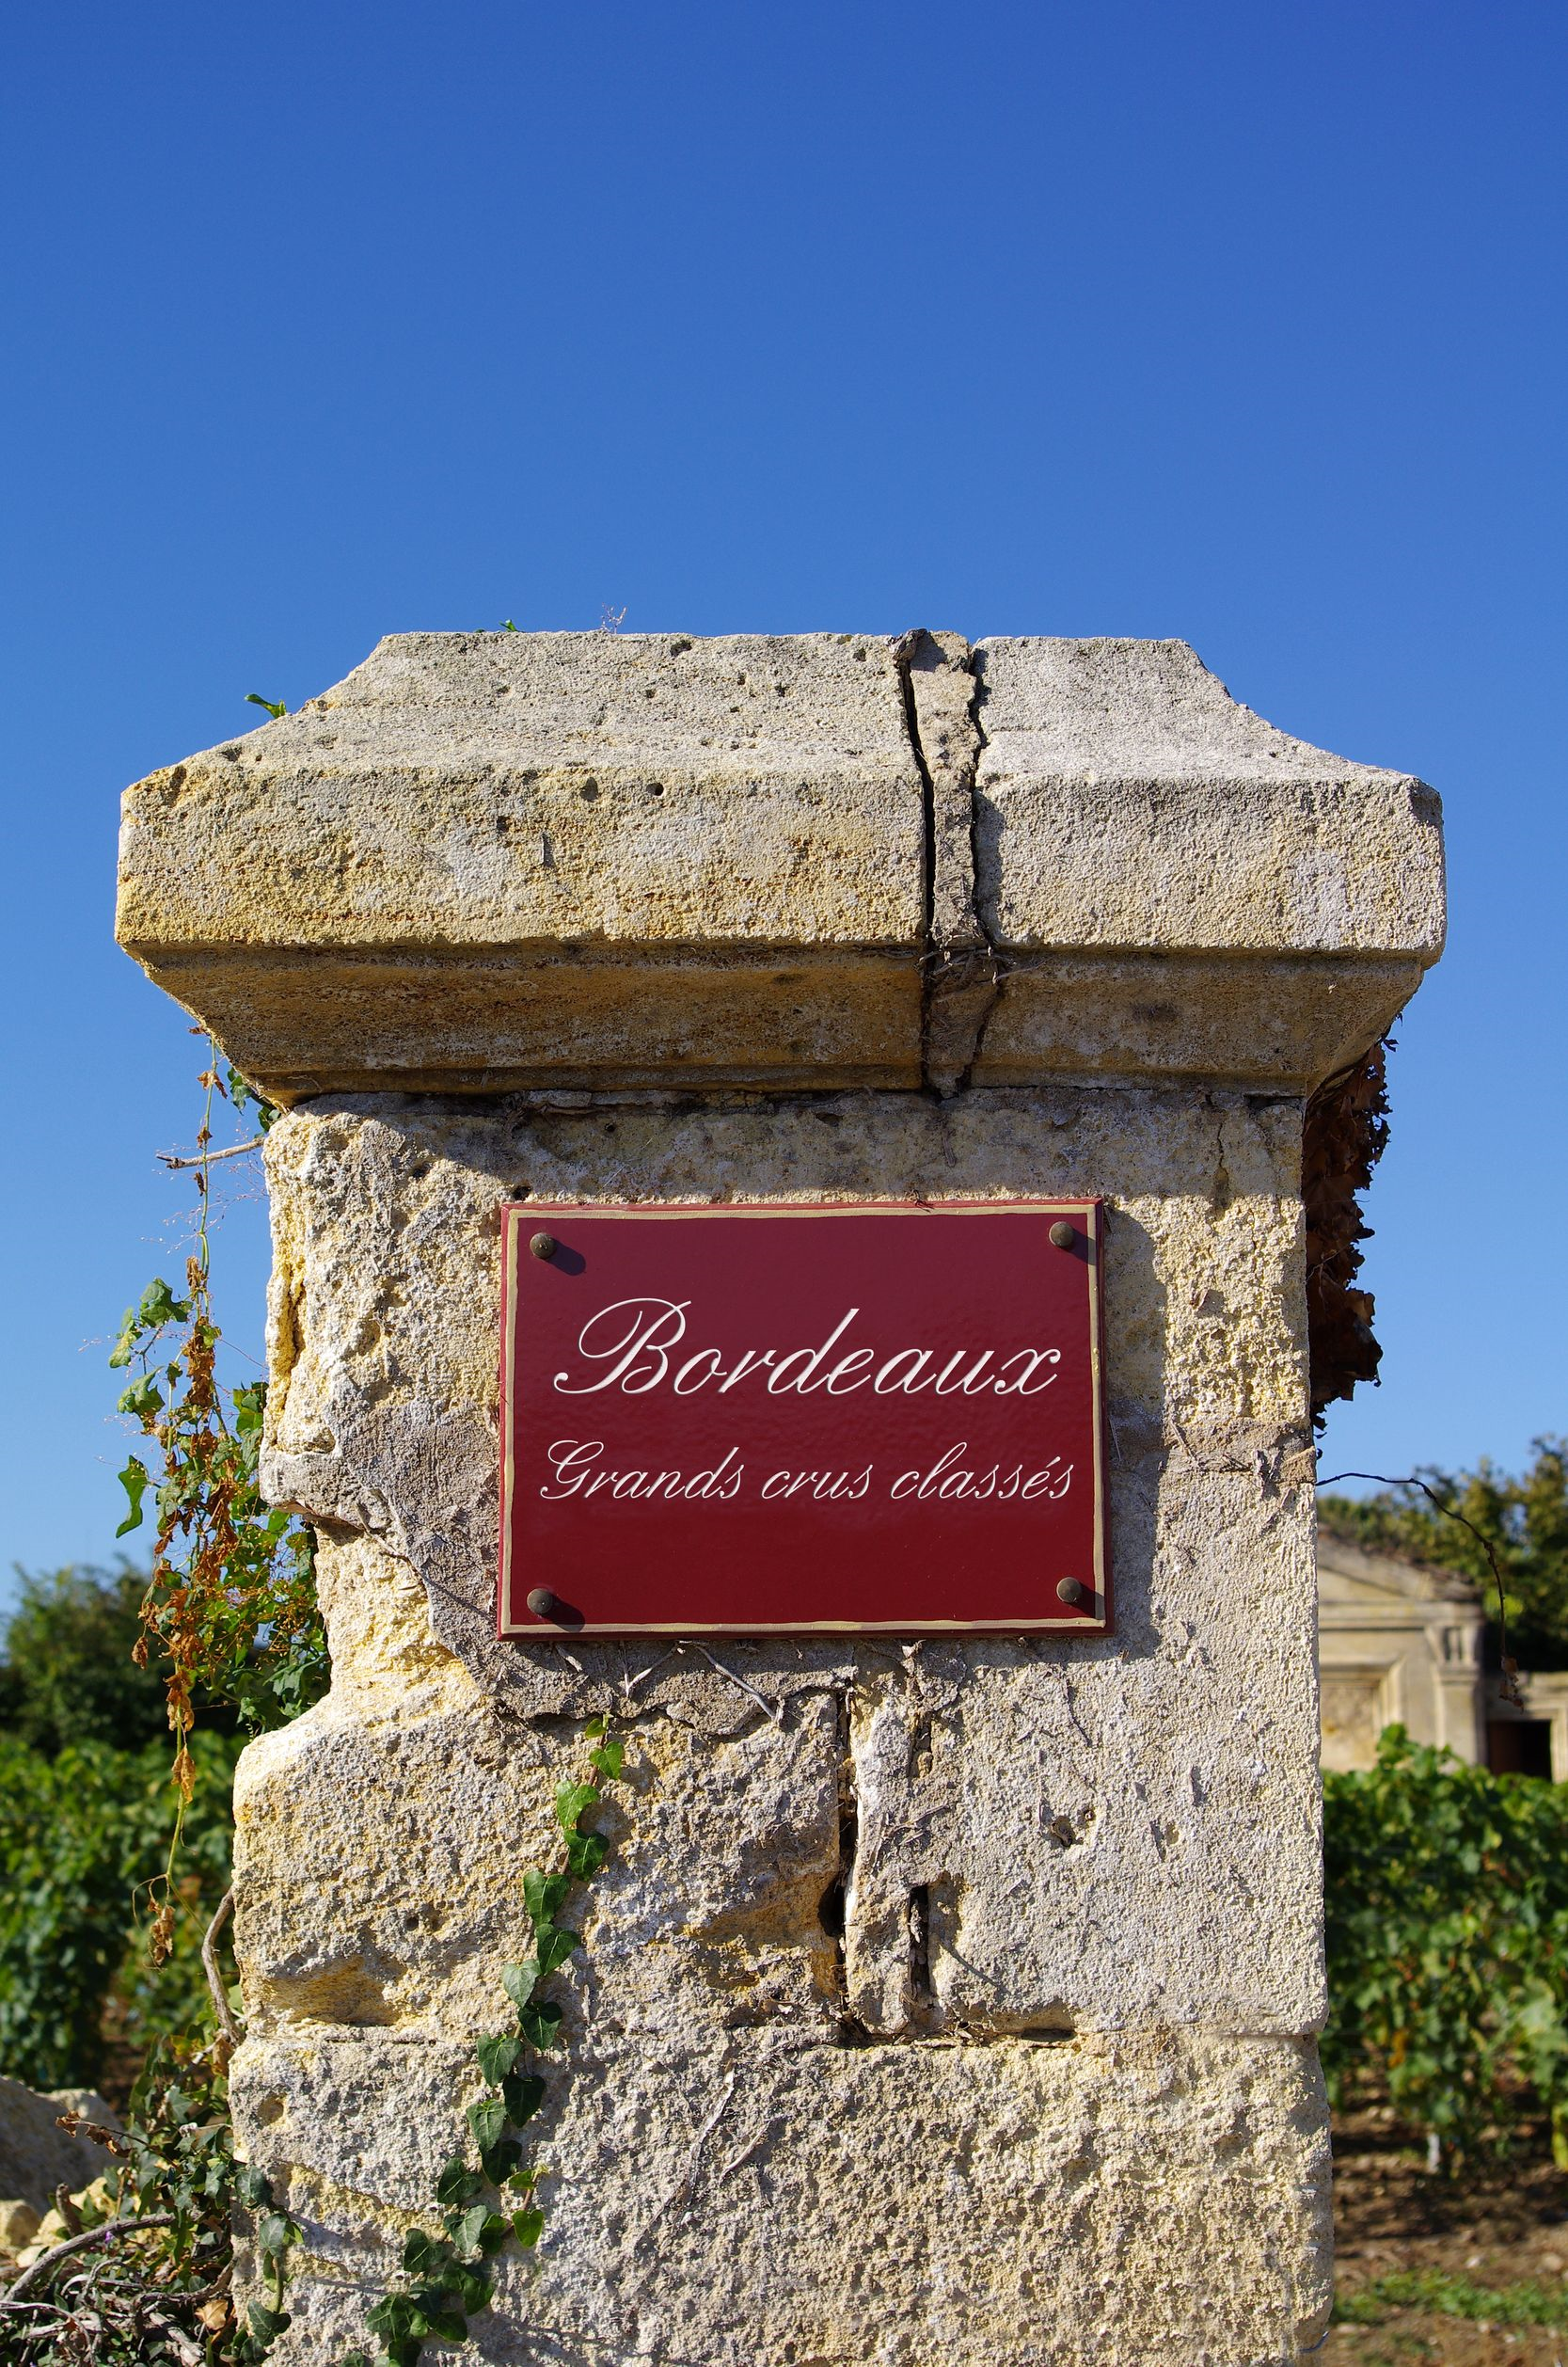
Slide #1

Slide 4
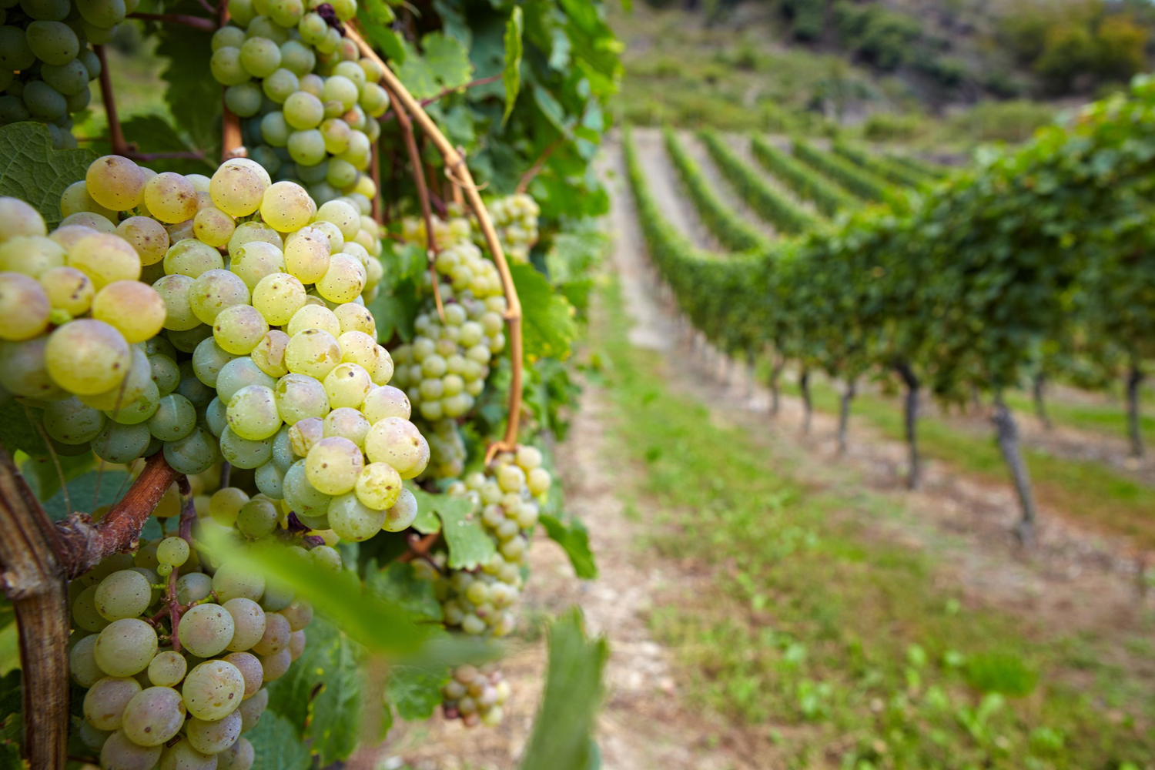
Slide #2

Slide 5
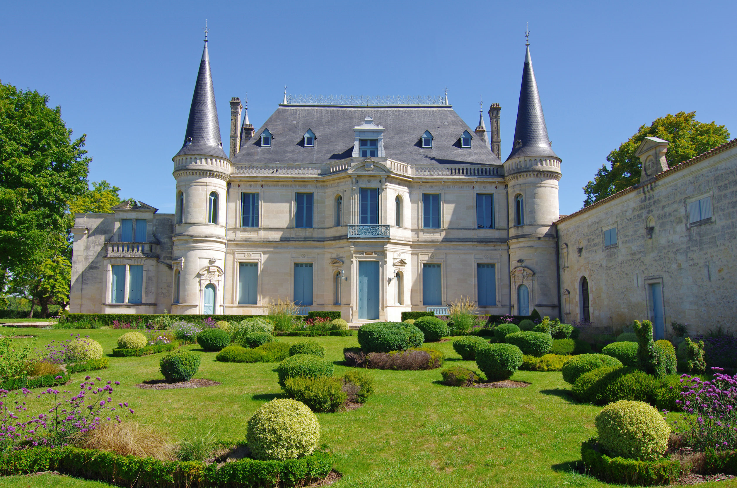
Slide #3

Slide 6
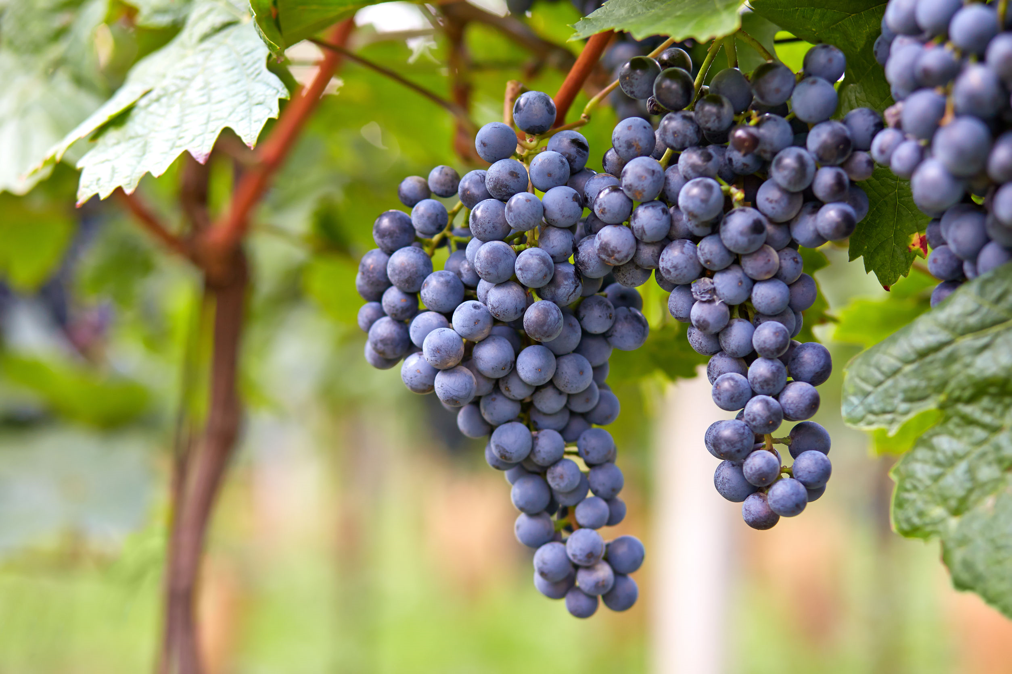
Slide #4

Slide 7
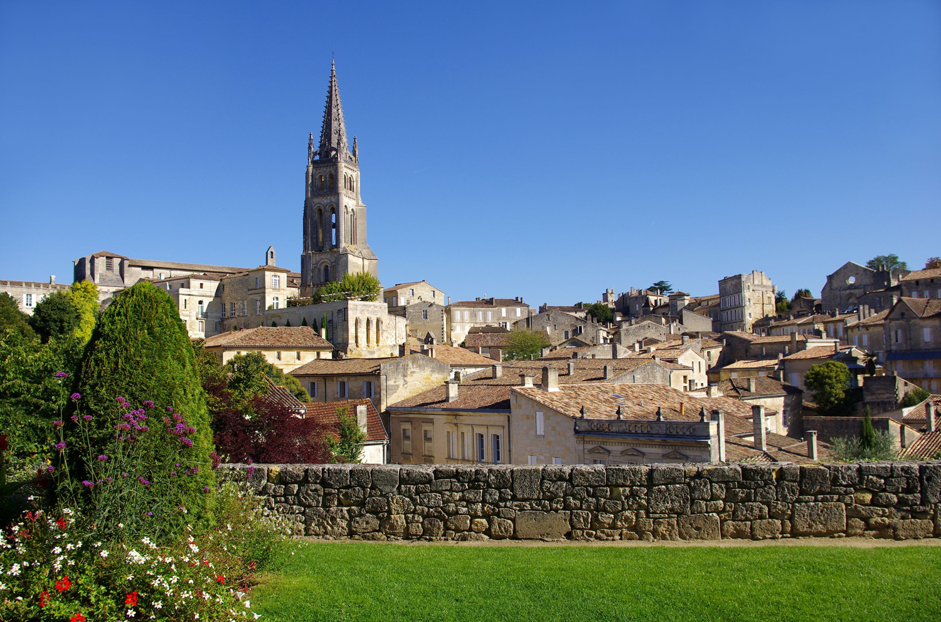
Slide #5

Slide 8
Thank you for joining us!
Any questions?
Gary Twining, CWE

