Slide 1
HERITAGE AND PLACE
UNDERSTANDING SHIRAZ REGIONALITY
AUSTRALIAN WINE DISCOVERED

Slide 2
Tonight’s
session
Australian Wine Discovered
History of Shiraz in Australia
Factors Affecting Style and Quality:
In The Vineyard
Regions, sites & soils
Clones and vine age
In The Winery
Whole cluster use
Fermentation vessels and temperatures
Oak use & ageing
Shiraz In The Glass
Characteristics and typical regional expressions

Slide 3
EDUCATION
MADE
OUR
WAY

Slide 4
TOPICS
AUSTRALIAN
VARIETIES
AUSTRALIAN
REGIONS
TOPICAL
Cabernet Sauvignon and blends
Chardonnay
Grenache and blends
Pinot Noir
Riesling
Semillon and Sauvignon Blanc
Shiraz and blends
Alternative varieties
Barossa
Coonawarra
Hunter Valley
Margaret River
McLaren Vale
Mornington Peninsula
Tasmania
Yarra Valley
Adelaide Hills
Clare Valley
Langhorne Creek
Introduction to wine
Foundations of Australian wine
Aged Australian wine
Australia’s old vines
Australian sparkling wine
Organic and biodynamic viticulture and winemaking
25
comprehensive programs

Slide 5
200+
EDITABLE MATERIALS
AND RESOURCES
TOOLS AND
DETAILED
EDITABLE
RESOURCES
GUIDES
PRESENTATIONS
Handouts, maps, attendance certificates, tasting lists, sheets, mats and more.
Comprehensive topic information and tips for facilitating a tasting, whether you’re an educator, winery, retailer, distributor, importer or other.
AND VIDEOS
Highly-visual PowerPoint slides and videos to convey key points and bring a tasting to life.
+
CONSUMER EBOOKS

Slide 6
FREE OPEN
GLOBAL ACCESS
Free program materials and resources
Unrestricted access
Global reach
www.australianwinediscovered.com

Slide 7
Shiraz is one of Australia’s most established and loved varieties.
Grown by 4 out of 5 wineries
Represents nearly half of planted red grapes
Nearly 1/4 of total wine production
AUSTRALIAN SHIRAZ:
THE STORY OF
AN AUSTRALIAN
LEGEND
FUN FACT
You say Syrah, we say Shiraz
This variety is called Syrah almost everywhere else in the world. However, due to its commercial success internationally, Australian producers have chosen to label their own wine “Shiraz”.

Slide 8
AMERICAN CABERNET
FRENCH PINOT NOIR
AUSTRALIAN SHIRAZ

Slide 9
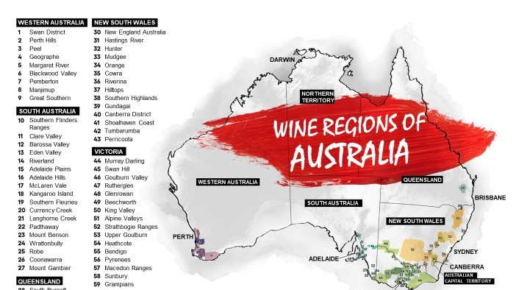

Slide 10
DARWIN
WORLD’S SIXTH-LARGEST COUNTRY,
BIGGER THAN EUROPE
IRELAND
SWEDEN
UK
GERMANY
POLAND
FRANCE
CZECH REPUBLIC
AUSTRIA
UKRAINE
GEOLOGICALLY ANCIENT
HUNGARY
BRISBANE
PORTUGAL
SPAIN
ROMANIA
AND BIOLOGICALLY DIVERSE
ITALY
YUGOSLAVIA
VINEYARDS ACROSS
PERTH
BULGARIA
THE COUNTRY, BUT
SYDNEY
CONCENTRATED IN THE
ADELAIDE
GREECE
CANBERRA
SOUTHEAST AND SOUTHWEST
THE COLD SOUTHERN OCEAN
MELBOURNE
KEEPS TEMPERATURES COOL
IN THE SOUTH, IDEAL FOR
MAKING WINE
HOBART
*Indicative only

Slide 11
PARIS
STRASBOURG
BURGUNDY
NANTES
DIJON
ONLY
135,000
FRANCE
HECTARES
(0.02%)
LYON
OF AUSTRALIA’S TOTAL LAND MASS IS
UNDER VINE
BORDEAUX
This is slightly less than Bordeaux and Burgundy combined.
BORDEAUX

Slide 12
1840s
–1890s
THE HISTORY OF
SHIRAZ IN AUSTRALIA
Shiraz vines are planted in South Australia and Victoria, producing fruit that represents the world’s oldest continuously producing Shiraz vines.
^{The history}
1820s
1860
–1830s
Shiraz is one of the original varieties brought to Australia and thrives in the warm, dry climate.
Tahbilk is established in Victoria and is home to some of the world’s oldest ungrafted, pre‑phylloxera plantings of Shiraz.

Slide 13
1950s
1867
–1970s
Henry Best plants Shiraz in his Great Western vineyard in Victoria, and these vines continue to thrive today.
Shiraz makes its move to become the most popular wine in the country.
EARLY
1900s
Shiraz continues to prosper in almost every corner of the country, with its suitability to Australia’s various climates, topography and soils superseding other varieties.

Slide 14
1980s
TODAY
–1990s
The reputation of cool‑climate Shiraz grows, standing proudly alongside traditional, rich, full‑bodied warm-climate styles of Australian Shiraz that are enjoyed all over the world.
Australia’s winemakers craft wines with deeper colour, higher alcohol levels and new oak maturation.
2000s
While blockbuster Shiraz is still being made, with inky depth and syrupy richness, tastes are increasingly appeased by more moderate styles.

Slide 15
VITICULTURE:
SHIRAZ
Clones and vine age
Viticultural practices
Viticultural hazards
IN THE VINEYARD

Slide 16
THE VINE
Vigorous, adaptable vine that can yield large quantities of grapes on a single vine, even in low-fertile soils.

Slide 17
Australia has the largest acreage of ungrafted old vines in the world
The oldest Shiraz, Mourvedre and Grenache vineyards are in the Barossa
Photo © Barossa Grape and Wine Association
OLD VINES

Slide 18
THE BAROSSA OLD VINE CHARTER
OLD VINE 35+ years
SURVIVOR VINE 70+ years
CENTENARIAN VINE 100+ years
ANCESTOR VINE 125+ years

Slide 19
IRRIGATION
Vines on shallow soil require irrigation, while old vines are largely dry-grown
Shiraz vines can cope in adverse conditions
If irrigated too generously, wines can lack flavour concentration

Slide 20
Controlling excessive growth
Canopy management techniques are important
PRUNING

Slide 21
Y I E L D
Dependent on several factors, including:
Age of vine
Vine vigour
Site characteristics

Slide 22
CLONES
Small gene pool
1654 is most widely planted and favoured clones
Other Clones include PT23 (Vic), BVRC 12 & 30 and SAVI 17 & 19 clones

Slide 23
SHIRAZ IN THE WINERY
Whole cluster use
Fermentation vessels and temperatures
Oak use & ageing

Slide 24
WINEMAKING:
TECHNIQUES
INFLUENCING SHIRAZ
STEMS
LEFT IN CONTACT
STEMS
ADDED
UNBROKEN GRAPE CLUSTERS STILL ON STEMS
WHOLE-BUNCH FERMENTATION
STEM INCLUSION
CARBONIC
MACERATION
MALOLACTIC FERMENTATION
NATIVE/WILD YEAST
FERMENTATION

Slide 25
WINEMAKING:
TECHNIQUES
INFLUENCING SHIRAZ
EXTENDED MACERATION TIMES
CO-FERMENTATION
RACK AND
RETURN
POST-FERMENTATION MACERATION
OAK
MATURATION
BOTTLING
AND AGEING

Slide 26
AUSTRALIAN
SHIRAZ REGIONS
NORTHERN TERRITORY
QUEENSLAND
WESTERN AUSTRALIA
SOUTH
AUSTRALIA
SWAN DISTRICT
HUNTER VALLEY
NEW SOUTH WALES
GEOGRAPHE
CLARE VALLEY
RIVERINA
BAROSSA
VICTORIA
CANBERRA DISTRICT
MARGARET RIVER
GREAT SOUTHERN
McLAREN VALE
BEECHWORTH
ADELAIDE HILLS
CENTRAL VICTORIA
0
500
RIVERLAND
Kilometres
TASMANIA

Slide 27
STYLES
OF SHIRAZ

Slide 28
SPARKLING
R E D
AN AUSTRALIAN
TREASURE
Australian ‘sparkling Burgundy’ has been produced with Shiraz grapes since 1881
The best example tend to see some oak maturation
Traditional Method is common
Surprisingly food friendly

Slide 29
NSW AND
ACT REGION
HUNTER
NEWCASTLE
CANBERRA DISTRICT
SYDNEY
WOLLONGONG
ACT

Slide 30
Birthplace of Australian wine industry
Warm, humid climate ideal for Shiraz fruit ripeness
Known for medium-bodied, savoury, complex wines
Young Hunter Shiraz displays red and dark berries, spice and lots of tannin
Aged Hunter Shiraz is smooth and richly flavoured with earthy tones and complexity
HUNTER
VALLEY

Slide 31
CANBERRA
DISTRICT
Emerging winemaking scene with strong drive for innovation
Shiraz is the red wine that has brought the Canberra District its greatest fame
Mix of geology, climate and expertise creates spicy, peppery, lean yet balanced and flavoursome Shiraz
Home to Clonakilla, producer of acclaimed Shiraz-Viognier blend

Slide 32
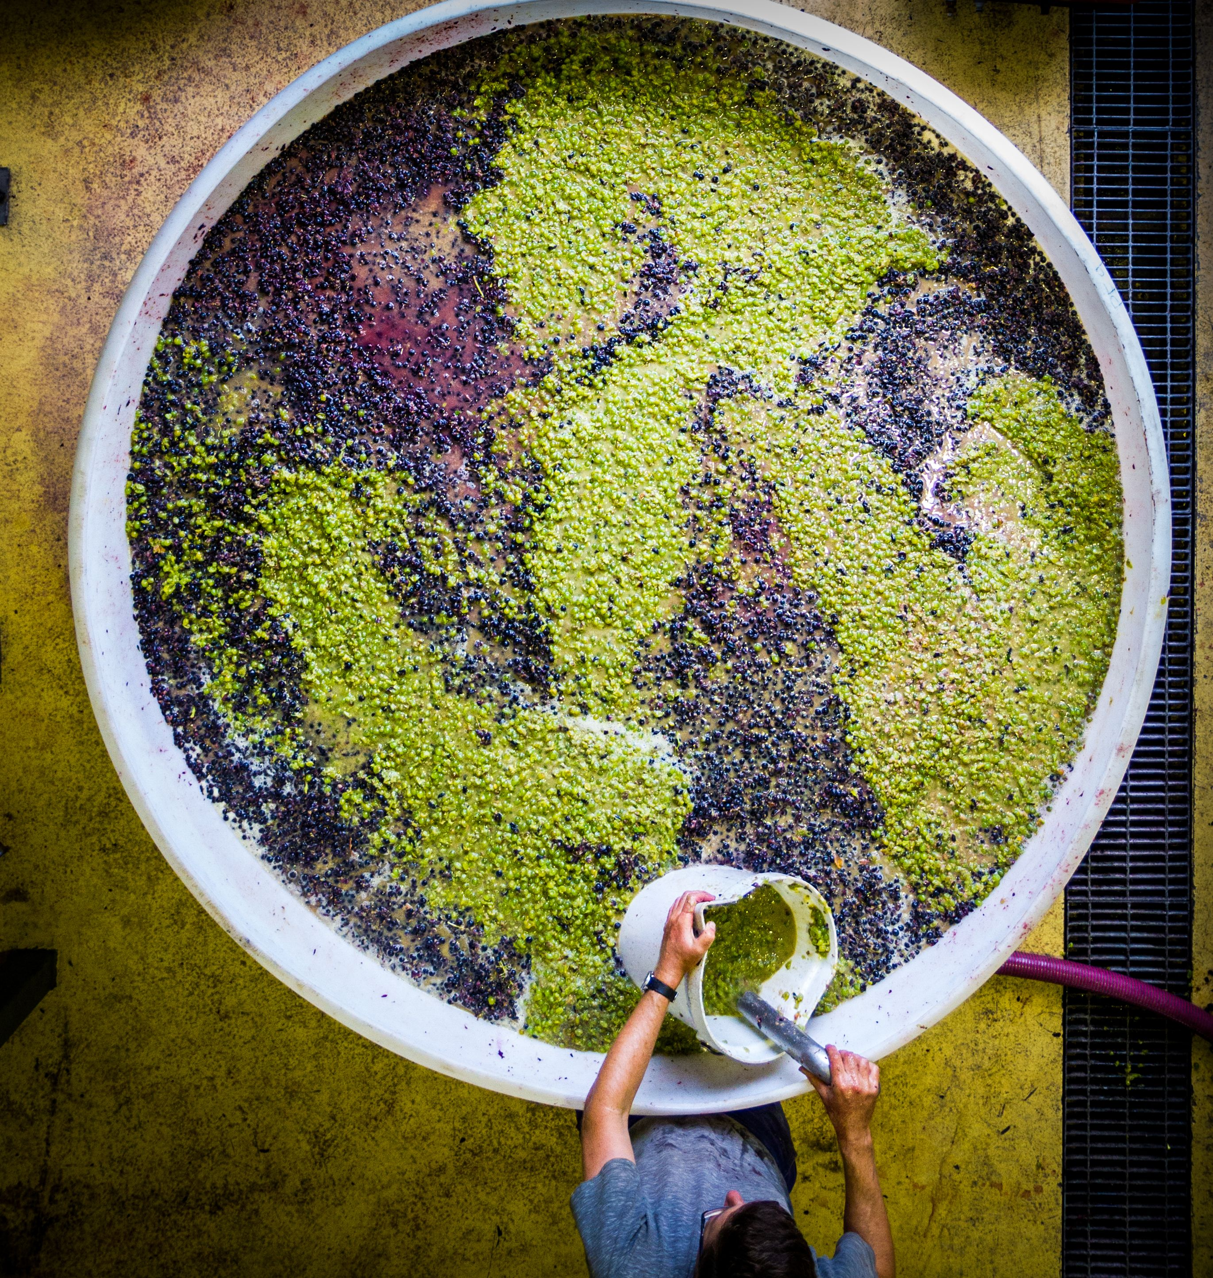

Slide 33
SOUTH
AUSTRALIA
Clare
Valley
Barossa
Valley
Eden Valley
ADELAIDE
McLaren Vale
Adelaide Hills

Slide 34
One of Australia's oldest and best-known Shiraz regions
Barossa Shiraz is one of the most widely available and best-known red wines in the global market
An important component in classic Shiraz-Cabernet and GSM blends
Full-bodied, richly textured wines with black fruit, pepper and spice characters
BAROSSA
VALLEY

Slide 35
EDEN VALLEY
Part of the greater Barossa Zone
High-altitude vineyards
Later harvest timing
Home to Henschke ‘Hill of Grace’ Shiraz
Medium-bodied to full-bodied Shiraz with classic blackberry, sage and pepper notes

Slide 36
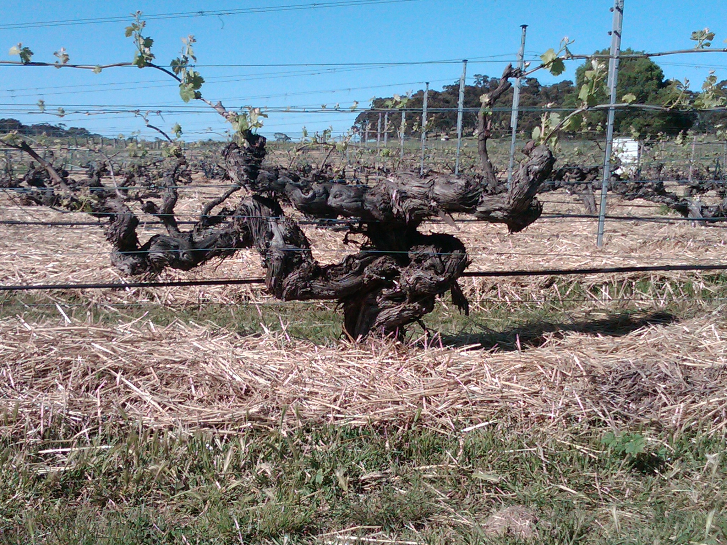

Slide 37
One of world’s most geologically diverse regions
Red wine wonderland
Shiraz is the most planted red variety in the region
Full-bodied Shiraz with rich blueberry fruit and chocolate characters
ONE OF AUSTRALIA'S PREMIER
SHIRAZ-GROWING REGIONS
MCLAREN
VALE

Slide 38
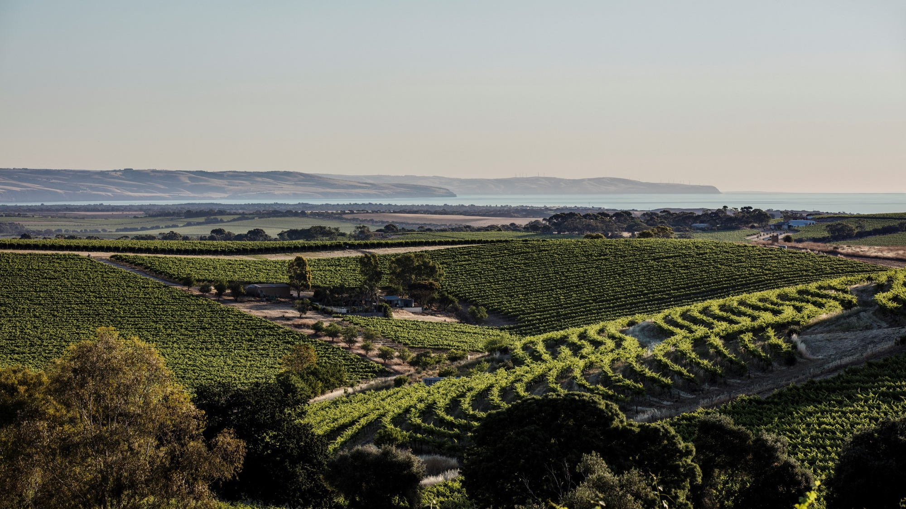

Slide 39
CLARE VALLEY
Fertile farming/agricultural region
Warm days help Shiraz develop richness, depth of flavour and fruit concentration
Consistently cool nights aid in acid retention
Decadent, opulent, rich Shiraz with black fruit flavours and an almost creamy texture

Slide 40
Oldest surviving German settlement in Australia
Cool maritime climate with high-elevation vineyards
Adelaide Hills Shiraz flouts the big-bodied robust nature of neighbouring Barossa and McLaren Vale wines
Elegant, medium-bodied Shiraz, with fragrant pepper and spice, and fine tannins
Lower alcohol levels make this cool-climate style a very food-friendly wine
ADELAIDE
HILLS

Slide 41
GRAMPIANS
BEECHWORTH
HEATHCOTE
MELBOURNE
VICTORIA

Slide 42
HEATHCOTE
Powerhouse of Shiraz production
Rich soil deposits of iron oxide contribute intense colour and flavour to Heathcote Shiraz
Robust, full-bodied Shiraz of power and weight, with complex fruit and great balance
Acid and tannin combine without dominating the fruit, giving the wine great cellaring capability

Slide 43
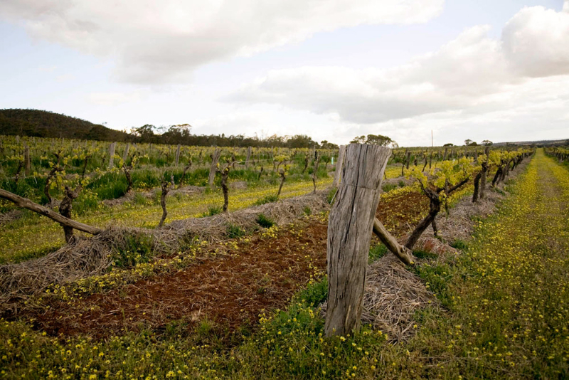

Slide 44
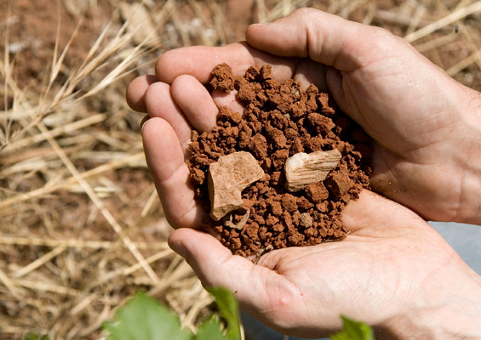

Slide 45
One of the country's oldest Shiraz vineyards planted in 1860s
Cooler-climate region – warm to hot days, cool nights
Region is especially well suited to later-ripening red varieties such as Shiraz
The Great Western sub-region is adept at producing elegant Shiraz of deep purple
Great Western Shiraz displays black pepper, plum, mint and clove, with fine but firm tannins
GRAMPIANS

Slide 46
BEECHWORTH
Cool climate, at the foothills of the Victorian Alps
Shiraz thrives in this cool sub-alpine climate
Shiraz expressions are medium in body, with savoury, spicy and earthy characters
Home to Giaconda, one of Australia’s premier producers of Shiraz and Chardonnay

Slide 47
SWAN DISTRICT
PERTH
W E S T E R N
AUSTRALIA
GEOGRAPHE
GREAT SOUTHERN
MARGARET RIVER

Slide 48
MARGARET
RIVER
Shiraz is the second most planted red grape, behind well-renowned Cabernet Sauvignon
Mediterranean climate with strong maritime influences, with oceans on three sides
Shiraz displays fruit ripeness, vibrancy, flavour depth and roundness of texture
Good acid level allows Shiraz to age gracefully

Slide 49
Southerly location gives it a cool maritime climate
Five distinct sub-regions
A healthy place for vine growth, almost free of pests and disease
Shiraz is medium in weight and exhibits an earthy blend of liquorice, spice, pepper, cherry and plum
Many producers avoid the heavy-handed use of American oak, allowing the fruit to shine through
GREAT
SOUTHERN

Slide 50
www.australianwinediscovered.com
Email me: mark.davidson@wineaustralia.com

Slide 51
T H A N K Y O U

